Slide 1

Instructions for KPIT’s Diploma Hiring - 6 June 2021

Slide 2

Registration Link : https://talentojo-kel.kpit.com/tojo/app/job-apply/#/Campus/36979/77 (You will receive a test link post successful registration)

Slide 3
Job Description and Required Skills

Slide 4
Job Description
Skills Required
Strong programming skills in C and C++
Good understanding of application development concepts
Good understanding of Computer architecture, various memories like ROM, RAM, EEPROM
Strong mathematical & analytical skills
Excellent communication and presentation skills (written and oral)
Ability to articulate well and have good clarity of thought/speech
High level of energy and confidence
Willingness to learn and innovate
Usage of MS Office Suite
Collaboration/meeting tools like MS Teams
Upon joining, you shall be expected to undertake jobs of the following nature (depending upon the vertical you are assigned to):
Work on projects in the domains of Autonomous Driving, Connected Vehicles, Mobility, Power-train or some other domains
Requirement's analysis
Design, understand algorithms/concepts, and convert them into a mathematical model
Testing and validation of code
Optimization and porting of code onto micro-processors

Slide 5
Joining CTC
Cost to Company (CTC) upon Joining:
A salary range of 2.7 Lac per year (LPA).
Please note that there is a two-year bond.
Other Benefits (may change / improve)
Medical Insurance for Employees- 6 Lac
Parental Health Insurance – 5 Lac for parents and in-laws (payment basis, 50% cheaper than market)
Personal Accident Insurance – 20 Lac
Free Annual Health check for employees and their family members (parents, in-laws, spouse)

Slide 6
Test Structure

Slide 7
Test structure
Day 1: 06 June 2021
(180 Mins in total)
10:00 AM to 1:00 PM – you are allowed to log into the test from 10:00 AM to 10:30 AM only
Day 2: 09 June 2021
(1 hour)
Behavioral Assessment
Please keep 09:00 AM to 11:00 AM free.
No preparation is required by the candidates.
Day 1:
Section A:-
Aptitude
Basic Math’s
Professional skills and English
C Language Basics
Algorithmic Thinking
Section B:-
CPP and OOPS
CPP Code Snippets
Coding Test
Shortlisted candidates
Offer letter to the selected candidates will be issued on or before 15 June 2021
7

Slide 8
Syllabus

Slide 9
Diploma
Day 1:
You should expect 60 Multiple Choice Questions in Section A & 35 Questions in Section B (Split:- 1 is coding Question & 34 is MCQ based Questions) on these topics / subjects for a time duration of 180 mins.

Slide 10
Example for C Language Basics
1. What will be the output of the following code:
void main() { char *p; p = "KPIT"; printf ("%c", *&*p);
}
Option 1: K
Option 2: KPIT
Option 3: Address of p
Option 4: None of the above

Slide 11
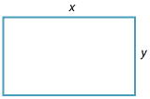
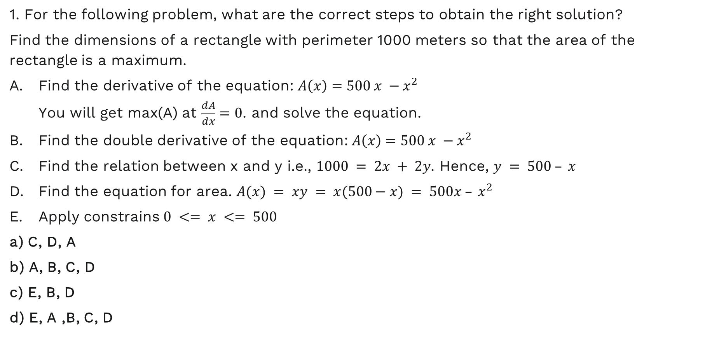
Example Problem on Algorithmic Thinking
1. For the following problem, what are the correct steps to obtain the right solution?
Find the dimensions of a rectangle with perimeter 1000 meters so that the area of the rectangle is a maximum.
Find the derivative of the equation: $A\left(x\right)=500 x −x^{2}$ You will get max(A) at $\frac{dA}{dx}=0$. and solve the equation.
Find the double derivative of the equation: $A\left(x\right)=500 x −x^{2}$
Find the relation between x and y i.e., $1000 = 2x + 2y$. Hence, $y = 500 – x$
Find the equation for area. $A(x) = xy = x(500−x) = 500x – x^{2}$
Apply constrains $0 <= x <= 500$
a) C, D, A
b) A, B, C, D
c) E, B, D
d) E, A ,B, C, D

Slide 12
Examples for CPP and OOPS
1. What will be the output of the following code: #include <iostream> using namespace std; class Test
{ Test() {cout << "Test Constructor called"; } };
int main() { Test t1; return 0; }
Option 1: Test Constructor called
Option 2: Compile-time error
Option 3: Run-time error
Option 4: None of the above

Slide 13
Examples for CPP Code Snippet
Q: Predict the output of the given code snippet?
#include <iostream> using namespace std; int i; class A { public: ~A() { i=10; } }; int foo() { i=3; A ob; return i; } int main() { cout << foo() << endl; return 0; } };
Option 1: 0
Option 2: 3
Option 3: 10
Option 4: None of the above

Slide 14
Rules for the Test (Very Important)

Slide 15

How Should You Arrange Your Test Environment?
Subtitle goes here
Please ensure that your monitor / laptop is close to a wall and no one can stand behind the monitor.
You will be asked to show the room anytime during the test. Hence …
Ensure that no one else is in your room during the test.
You should not have any digital device or textbook around you when the test is being conducted.
You should not keep a mobile-phone or any video-casting device around you.
Please have a high-resolution camera mounted on the monitor. Do not change its position.
Please do keep some rough-paper, pen and calculator with you, because many questions would require calculations.
No water-breaks / toilet-breaks are allowed. Please, do keep some water and snacks handy.
The test-platform shall automatically log you out if …
Your complete face is not visible throughout the test.
Please ensure that you are facing a light-source, so that your face is clearly visible. Also, there should not be any light-source behind you.
Someone else is talking in the room or there is some noise in the room.
You are wearing tinted glasses or sun-glasses.
You are browsing any web-site.
You connect any additional monitor over VGA, HDMI or Bluetooth / Wi-Fi.

Slide 16
About the Assessment Platform

Slide 17
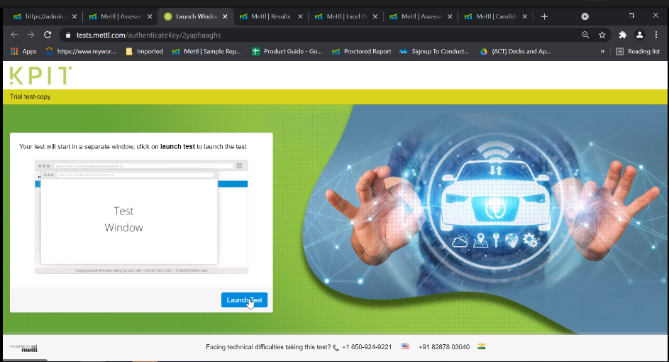
Steps to log in to the mettl platform
If you have any challenge at this step, please contact the Campus Team, KPIT at campus@kpit.com. Please do not communicate with anyone else.

Slide 18
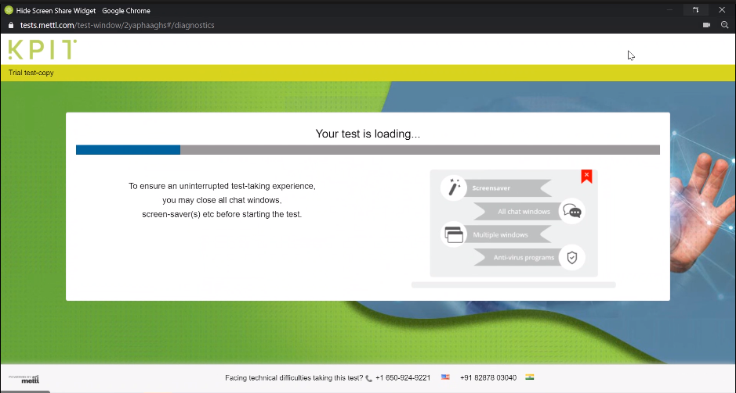
Steps to log in to the mettl platform
If you have any challenge at this step, please contact the Campus Team, KPIT at campus@kpit.com. Please do not communicate with anyone else.

Slide 19
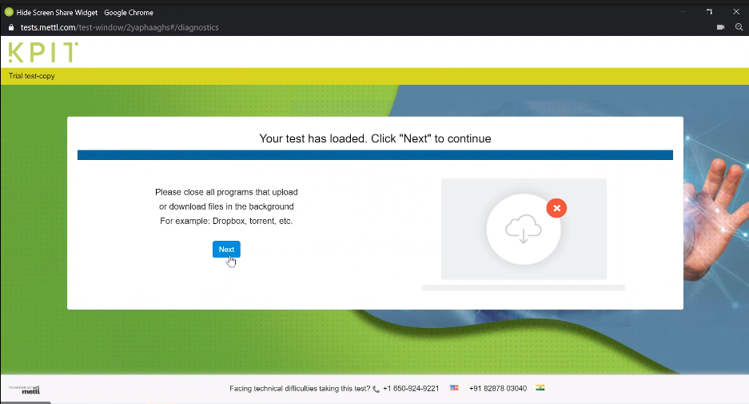
Steps to log in to the mettl platform
If you have any challenge at this step, please contact the Campus Team, KPIT at campus@kpit.com. Please do not communicate with anyone else.

Slide 20
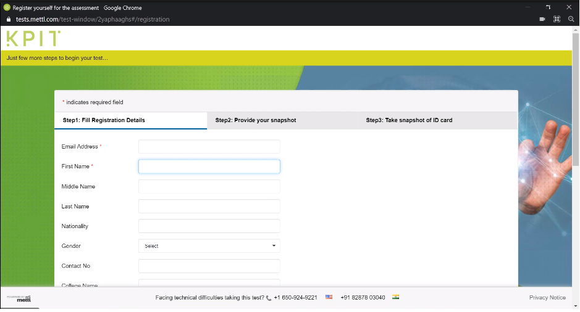
Steps to log in to the mettl platform
If you have any challenge at this step, please contact the Campus Team, KPIT at campus@kpit.com. Please do not communicate with anyone else.

Slide 21
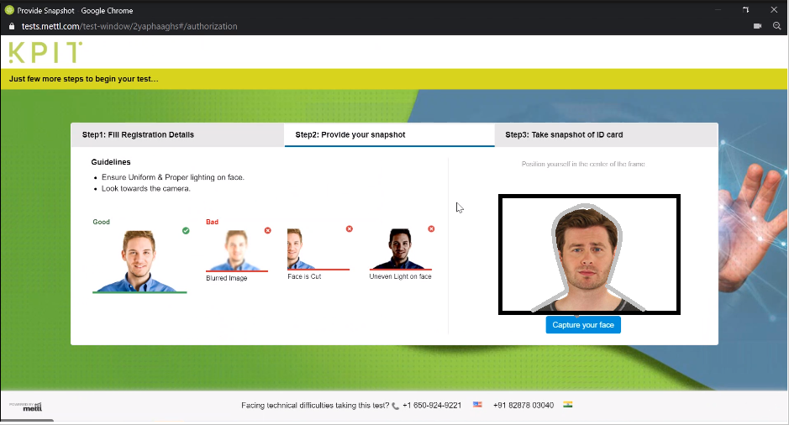
Steps to log in to the mettl platform
If you have any challenge at this step, please contact the Campus Team, KPIT at campus@kpit.com. Please do not communicate with anyone else.

Slide 22
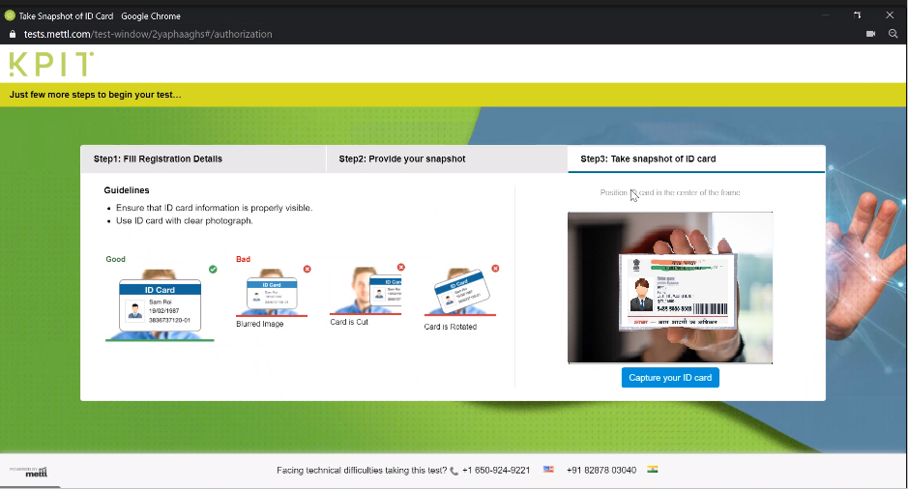
Steps to log in to the mettl platform
Keep your Aadhar card / Govt. ID handy to authenticate yourself.
It should be a non-laminated card. Mobile-photos will not be allowed.
If you have any challenge at this step, please contact the Campus Team, KPIT at campus@kpit.com. Please do not communicate with anyone else.

Slide 23
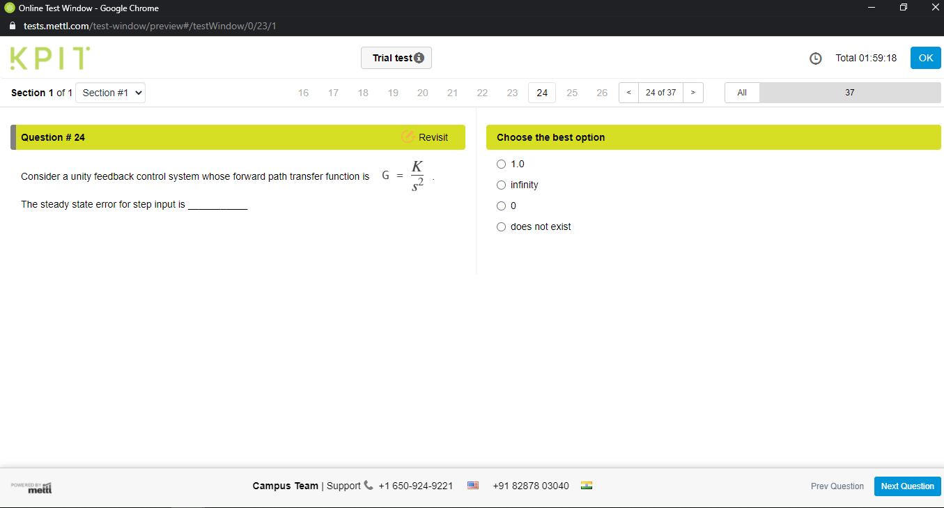
Your MCQ test environment will look like this
If you have any challenge at this step, please contact the Campus Team, KPIT at campus@kpit.com. Please do not communicate with anyone else.

Slide 24

Key Takeaways
You should remember following things before you appear for this test.
Reliable and high-speed internet connection.
A High-Resolution camera so we can proctor your test.
Dedicated time for the test duration and for the initial registration process.

Slide 25

Further Process
After Day 1 test, we will share the list of shortlisted candidates for Day 2.
Final selected candidates shall be intimated on or before 8 June 21.

Slide 26

Contact Details for this Process
Campus Team, KPIT
campus@kpit.com
Please do not communicate with anyone else.
KPIT does not charge any money from anyone for the Recruitment Process.
Beware of Fraudsters !!!
In case of fraud, KPIT Legal / Campus Team will be unable to help you in any manner.

Slide 27

All the best for this test !

Slide 28
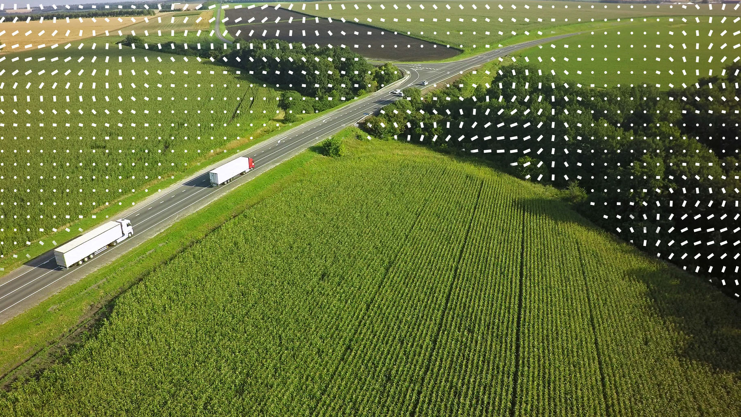
Thank You

